Slide 1
Feature Engineering using snowflake and Feature store
Assignment Submission
Presented by: Asutosh Parija
Date: 13th December 2025

Slide 2
Project Overview
Build a small ML pipeline completely inside snowflake.
Perform feature engineering.
Store engineering features in a feature store.
Run a simple ML prediction using SQL

Slide 3
What is Feature Engineering
Process of transforming raw data into useful inputs for ML
Helps models understand patterns better
Increases model accuracy and stability

Slide 4
Why Feature Engineering is Important
Improves model performance
Reduces noise.
Creates domain-based insights (age groups, salary buckets).
Makes training consistent

Slide 5
Types of Feature Engineering
Normalization: Scale value
Categorical Encoding: Bucket Categorised
Derived Features: Age group
Run a simple ML prediction using SQL

Slide 6
How snowflakes Stores Data
Stores structured & semi-structured data
Uses databases → schemas → tables
Automatically scales computation
Data is stored securely in cloud storage

Slide 7
Create Our Warehouse
Using some SQL command a warehouse is created as
create or replace warehouse COMPUTE_WH
warehouse_size = 'XSMALL'
auto_suspend = 60
auto_resume = true;
use warehouse COMPUTE_WH;
create or replace database FEATURE_DB;
use database FEATURE_DB;

Slide 8
Create Schema and Tables
Using some SQL command some schema and tables within them are created
CREATE TABLE raw.customers (
customerId INT,
customerName STRING,
age INT,
salary FLOAT,
country STRING
);
INSERT INTO raw.customers (customerId, customerName, age, salary, country)
VALUES
(1, 'John', 28, 52000, 'USA'),
(2, 'Alice', 35, 67000, 'UK'),
(3, 'Ravi', 22, 45000, ‘India');
SELECT * FROM customers;

Slide 9
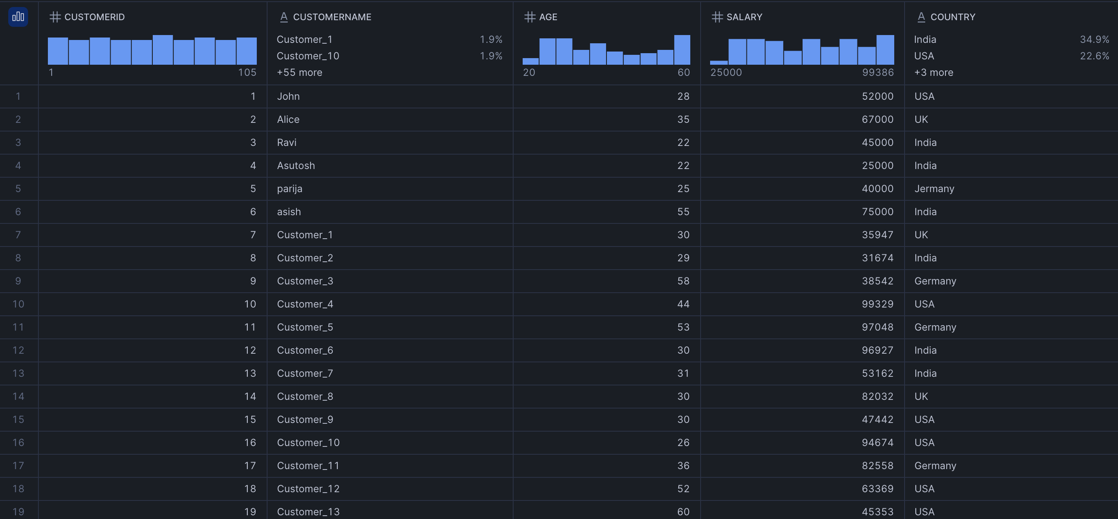
Output:

Slide 10
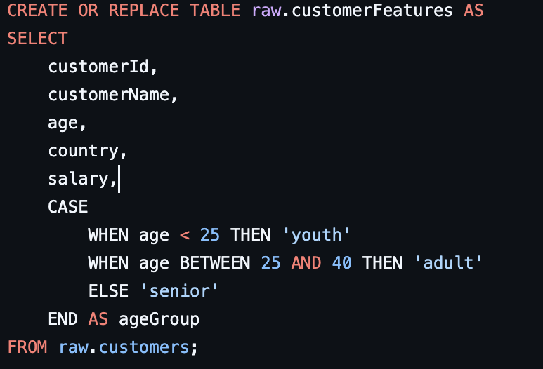
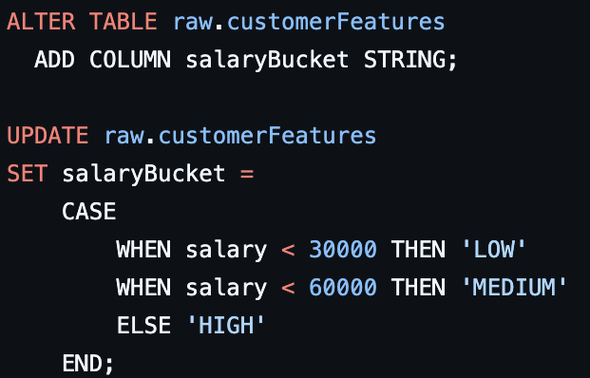
Preprocessing:
We do some preprocessing and stored the new data in another storage as customerFeature

Slide 11
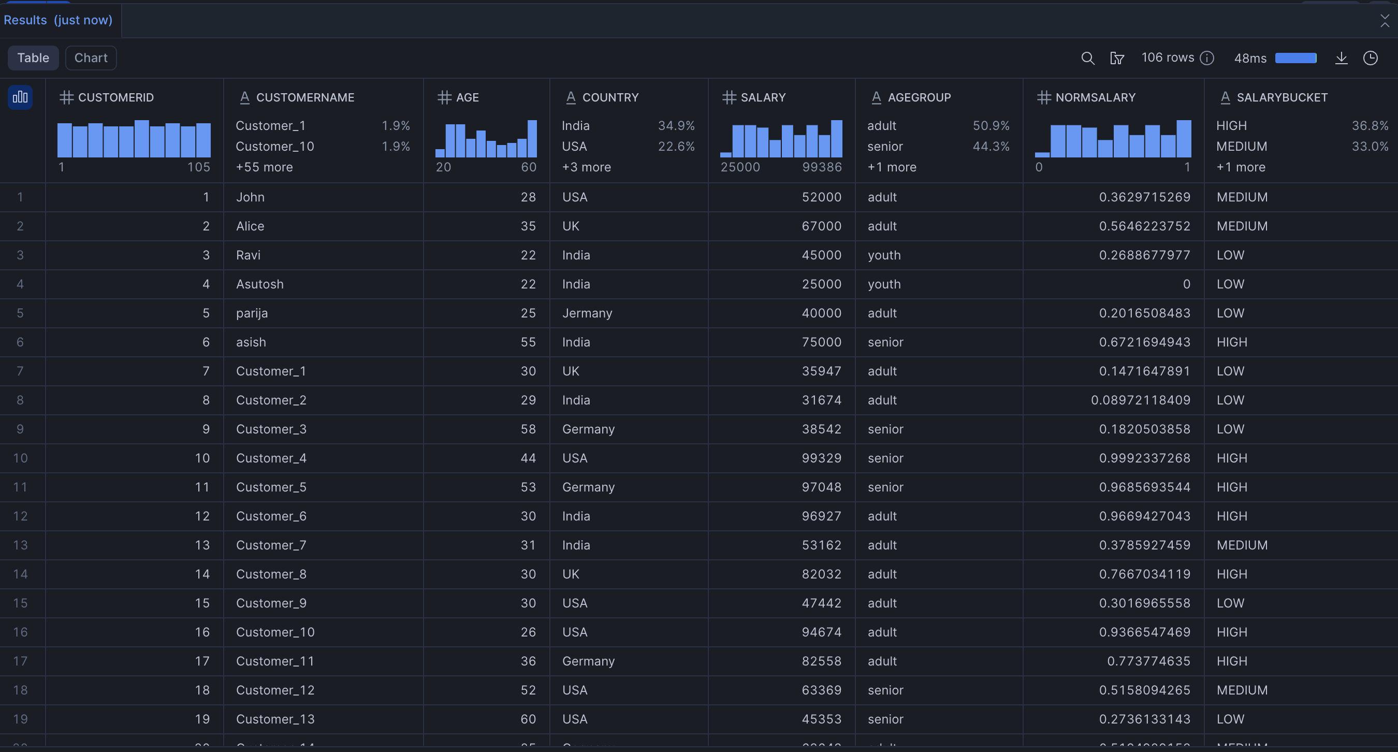
Result of Preprocessing

Slide 12
Feature Store
Central place to store clean and usable data for further ML use.
Runs pipeline to convert raw data into meaningful features .
Delivers features for model training.

Slide 13
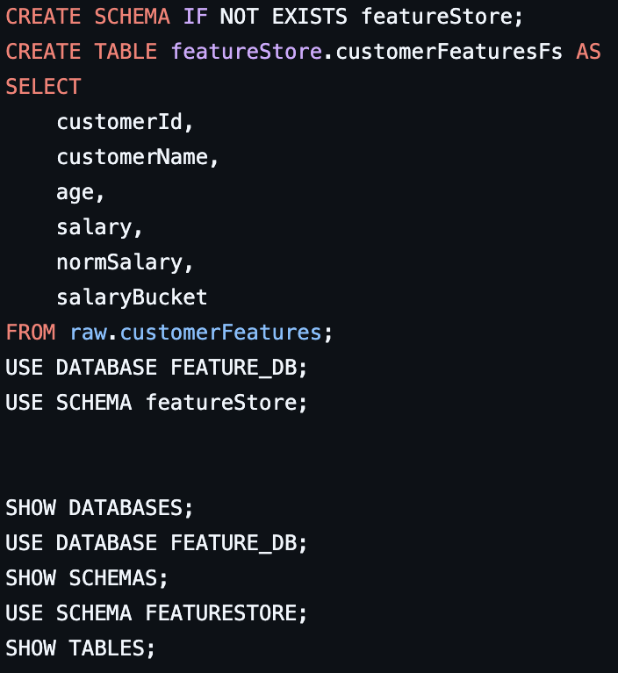
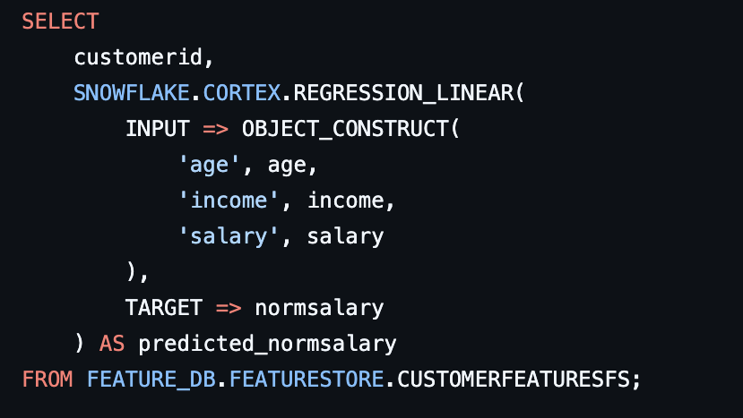
Feature Engineering
Using SQL command to create the feature data with the help of our previously
processed data

Slide 14
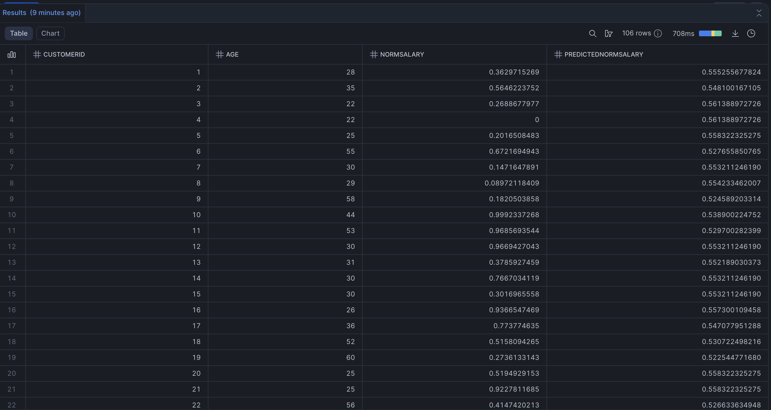
Feature Engineering
And the outputs are as follows

Slide 15
Conclusion
Snowflake handle Data storage, Feature engineering and Model prediction in one place.
Feature engineering ensure the clean and usable data.
Regression model was implemented fully using SQL.

Slide 16
Thank You

